Slide 1


Organizational Behavior
(MGT-502)
Lecture-7

Slide 2
Summary of
Lecture-6

Slide 3
The Importance of Values
Behavior
Motivation
Perceptions
Attitudes
Values

Slide 4
Sources of values.
  Parents.
  Friends.
  Teachers.
  Role models.
  External reference groups.

Slide 5
Values Across Cultures
Power Distance
Individualism or Collectivism
Quantity or Quality of Life
Uncertainty Avoidance
Long-Term or Short-Term

Slide 6
Handling Cultural Differences
Learn about others’ values
Avoid prejudging
Operate legitimately within others’ ethical points of view
Avoid rationalizing
Refuse to violate fundamental values
Be open
Notes:
18

Slide 7
Today’s Topics

Slide 8
The Importance of Values
Behavior
Motivation
Perceptions
Attitudes
Values

Slide 9
Rights
  Right: a person’s just claim or entitlement
  Focuses on the person’s actions or the actions of others toward the person
    Legal rights: defined by a system of laws
    Moral rights: based on ethical standards
  Purpose: let a person freely pursue certain actions without interference from others

Slide 10
Attitudes
Values

Slide 11
Attitudes Define
An attitude is a mental stage of readiness, learned and organized through experience, exerting a specific influence on a person’s response to people, objects, and situations with which it is related.
A persistent tendency to feel and behave in a particular way toward some object.

Slide 12
Components of Attitudes
Cognitive -- thinking
Affective -- feeling
Behavioral -- doing

Slide 13
Attitudes
Evaluative statements or judgments concerning objects, people, or events.
  Cognitive component of an attitude is the opinion or belief segment of an attitude.
  Affective component is the emotion or feeling segment of an attitude.
  Behavioral component of an attitude is an intention to behave in a certain way toward someone or something.
Sources of Attitudes
  Acquired from parents, teachers, and peer group members.
  “Genetic” predispositions.
  Observations, attitudes that we imitate.
Attitudes less stable than Values

Slide 14
Evaluative statements or judgments concerning objects, people, or events.
Sources of Attitudes
  Acquired from parents, teachers, and peer group members.
  Genetic? predispositions.
  Observations, attitudes that we imitate.
Attitudes less stable than Values

Slide 15
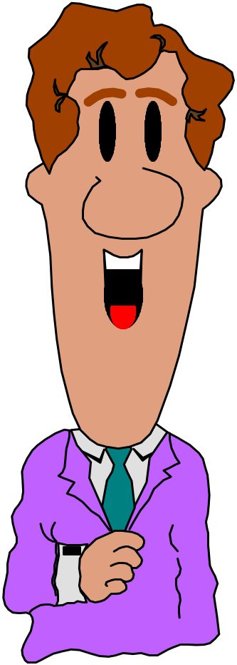
Types of Attitudes
Job satisfaction
Job involvement
Organizational commitment

Slide 16
Types of Attitudes
Job Satisfaction
  . . . refers to an individual’s general attitude toward his or her job.
Job Involvement
  . . . measures the degree to which a person identifies psychologically with his or her job and considers his or her perceived performance level important to self-worth.
Organizational Commitment
  . . . a state in which an employee identifies with a particular organization and its goals, and wishes to maintain membership in the organization.

Slide 17
The Three Components of Attitudes
Stimuli
Work environment factors
Job Design
Managerial style
Company policies
Technology
Cognition
Beliefs and values
“My supervisor is unfair.”
“Having a fair supervisor is important to me.”
Affect
Feelings and emotions
“I don’t like my supervisor.”
Behavior
Intended behavior
“I’m going to request a transfer.”

Slide 18
Job Satisfaction
What Determines Job Satisfaction?
  Mentally Challenging Work
  Equitable Rewards
  Supportive Working Conditions
  Supportive Colleagues
  Personality - Job Fit
  Heredity/Genes
Job Satisfaction and Employee Performance
  Satisfaction and Productivity
  Satisfaction and Absenteeism
  Satisfaction and Turnover

Slide 19
Implications for Managers
Values strongly influence a person’s attitudes.
An employee’s performance and satisfaction are likely to be higher if his or her values fit well with the organization.
Managers should be interested in their employees’ attitudes because attitudes give warning signs of potential problems and because they influence behavior.

Slide 20
What is Meant by Job Satisfaction?
Job Satisfaction is an emotional response to a job situation
Job Satisfaction determined by how well outcomes meet or exceed expectations
Job Satisfaction represents several related attitudes
  The work itself
  Pay
  Promotion opportunities
  Supervision
  Coworkers

Slide 21
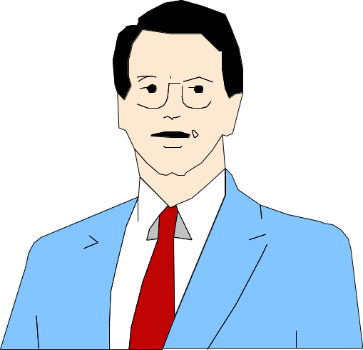
Attitudes Associated with Job Satisfaction
Work Itself
Job Security
Co-workers
Supervision
Promotion Opportunities
Working Conditions
Pay

Slide 22
Outcomes of Job Satisfaction
Satisfaction and Productivity
Satisfaction and Turnover
Satisfaction and Absenteeism
Satisfaction and Citizenship Behavior

Slide 23
The Effect of Job Satisfaction on Employee Performance
Satisfaction and Productivity
  Satisfied workers aren’t necessarily more productive.
  Worker productivity is higher in organizations with more satisfied workers.
Satisfaction and Absenteeism
  Satisfied employees have fewer avoidable absences.
Satisfaction and Turnover
  Satisfied employees are less likely to quit.
  Organizations take actions to cultivate high performers and to weed out lower performers.

Slide 24

Job Satisfaction and OCB
Satisfaction and Organizational Citizenship Behavior (OCB)
  Satisfied employees who feel fairly treated by and are trusting of the organization are more willing to engage in behaviors that go beyond the normal expectations of their job.

Slide 25
Are happy workers better workers?
Satisfaction causes performance
Performance causes satisfaction
rewards causes both performance and satisfaction

Slide 26
Satisfaction-Performance Relationship: Three Views
1. Job satisfaction
Job Performance
“The satisfied worker is more productive.”
2. Job satisfaction
Job Performance
“The more productive worker is satisfied.”
Perceived equity
3. Job performance
Rewards
Job satisfaction

Slide 27
Responses to Job Dissatisfaction
Active
Exit
Voice
Destructive
Constructive
Neglect
Loyalty
Passive

Slide 28
Barriers to Change Attitudes
Prior Commitments
Insufficient Information

Slide 29
Both personality and attitudes are complex cognitive processes. The difference is that personality usually is thought of as the whole person, while attitudes may make up the personality.

Slide 30
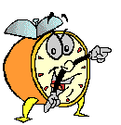
Let’s stop it here

Slide 31
Summary

Slide 32
Attitudes
Values

Slide 33
Components of Attitudes
Cognitive -- thinking
Affective -- feeling
Behavioral -- doing

Slide 34
Types of Attitudes
Job satisfaction
Job involvement
Organizational commitment

Slide 35
Outcomes of Job Satisfaction
Satisfaction and Productivity
Satisfaction and Turnover
Satisfaction and Absenteeism
Satisfaction and Citizenship Behavior

Slide 36
Barriers to Change Attitudes
Prior Commitments
Insufficient Information

Slide 37
Next….

Slide 38
Personality
Personality refers to a relatively stable set of feelings and behaviors that have been significantly formed by genetic and environmental factors.
Personality is a product of Nature and Nurture
Nurture
Pattern of life experiences
Nature
Hereditary
forces

Slide 39
Organizational Behavior
(MGT-502)
Lecture-7

